Slide 1
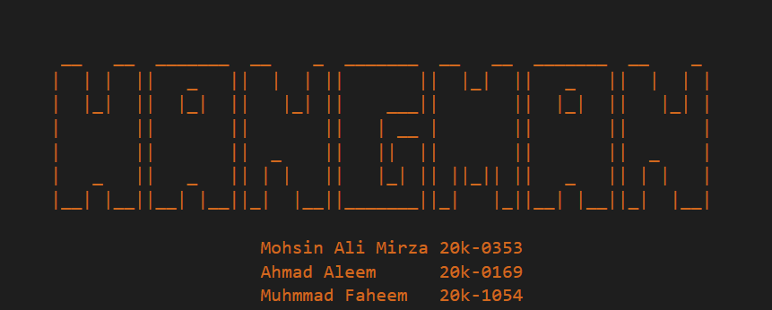

Slide 2
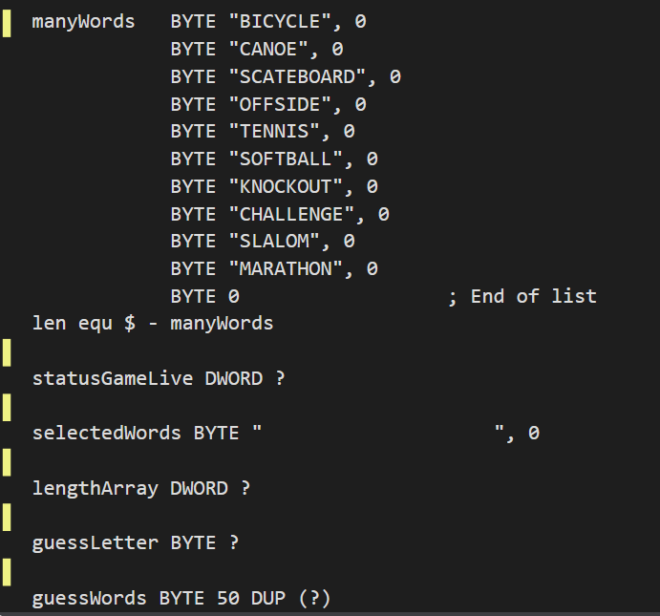
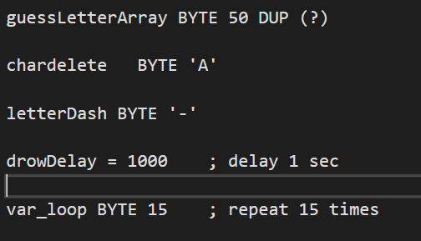
Variables Used

Slide 3
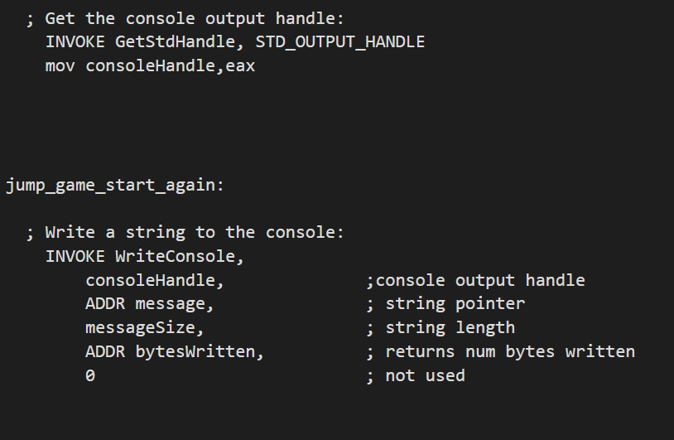
Main Proc Block 1:
Activating the console and printing the heading of the game.

Slide 4
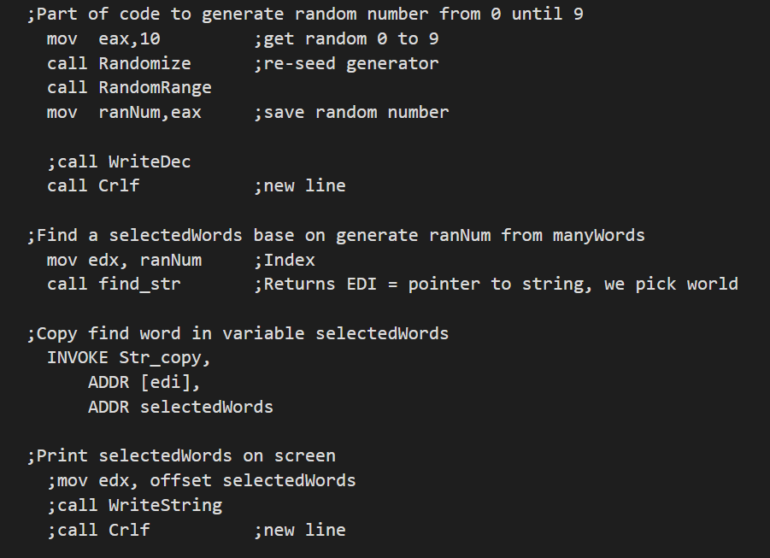
Main Proc Block 2:
Calling Randomize function to get the length of the word and finding the word of the desired length.

Slide 5
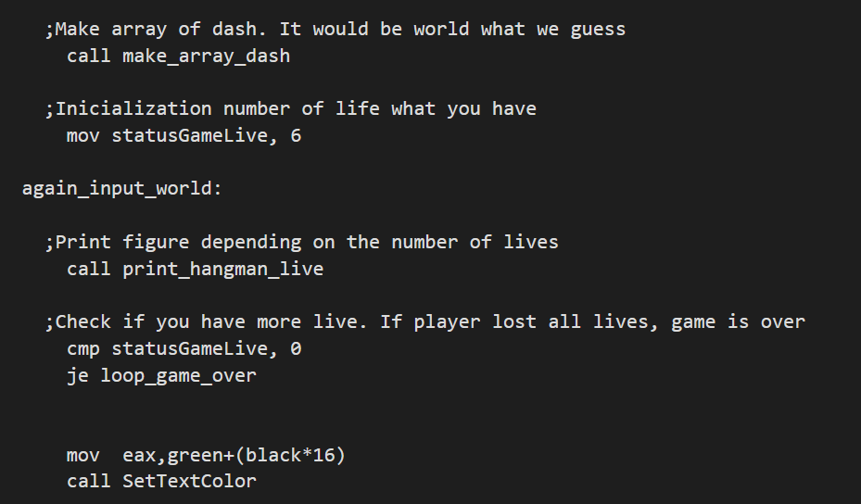
Main Proc Block 3:
Printing an array of dash of the evaluated length and initializing game lives.

Slide 6
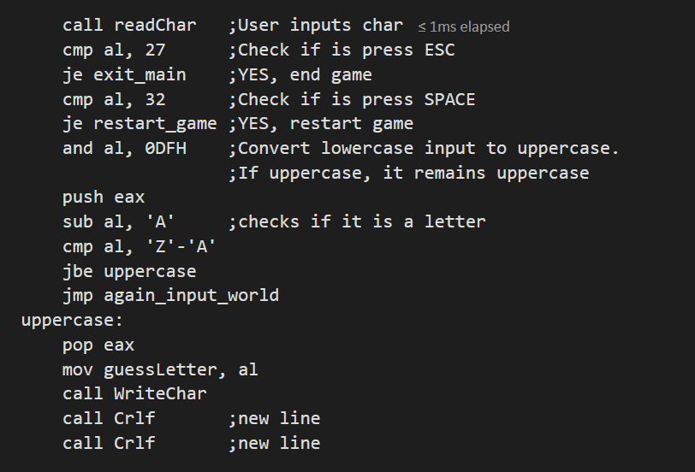
Main Proc Block 4:
Getting a character from the user and checking the basic checks. (ESC, SPACE, Letter Check)

Slide 7
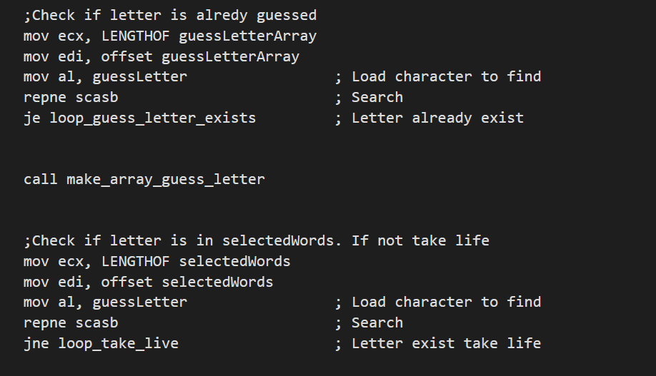
Main Proc Block 5:
Conditional Check to check if the letter is not being repeated or if the guessed letter doesn’t match any of the letters in the string.

Slide 8
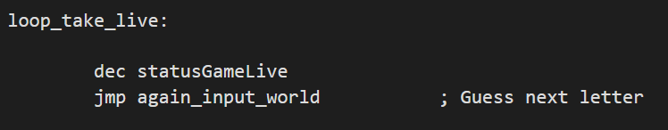
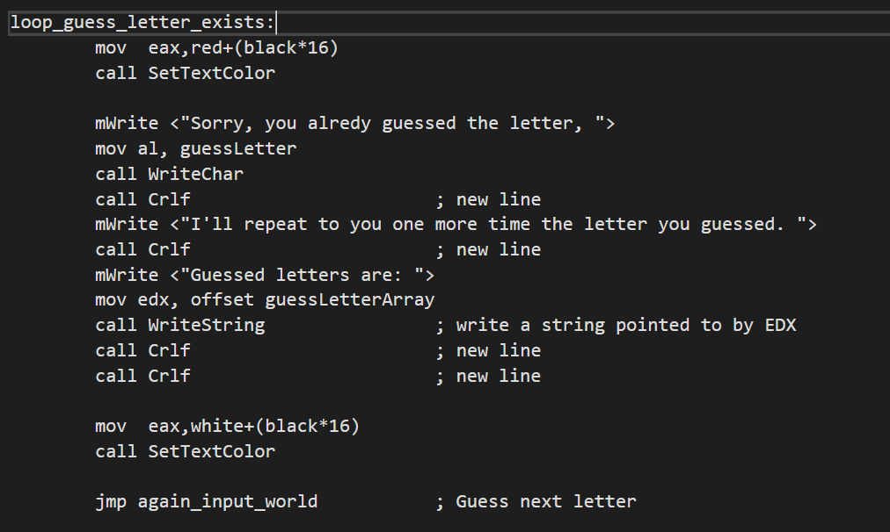
Labels:
Take Life Label
Guess Letter Label

Slide 9
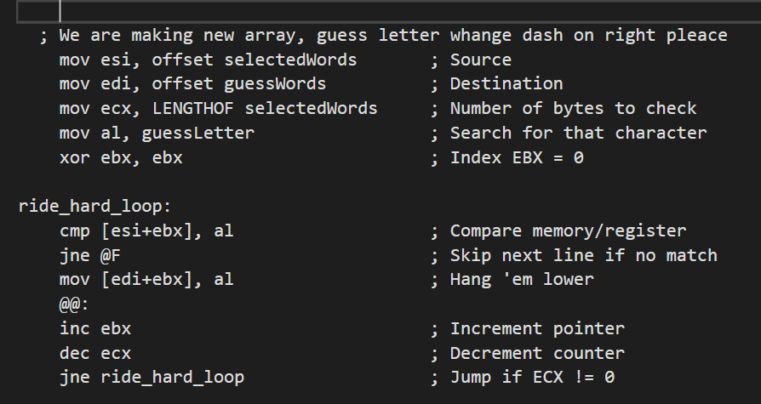
Main Proc Block 6:
Searching the guessed word from the whole string and replacing the dash with the letter.

Slide 10
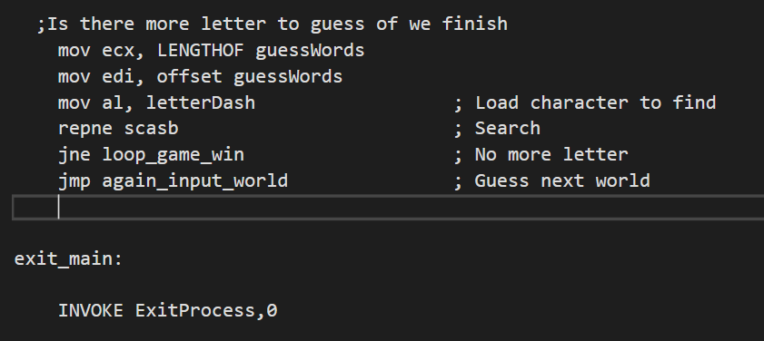
Main Proc Block 7:
Checking if the there are letters
remaining to be guessed.

Slide 11
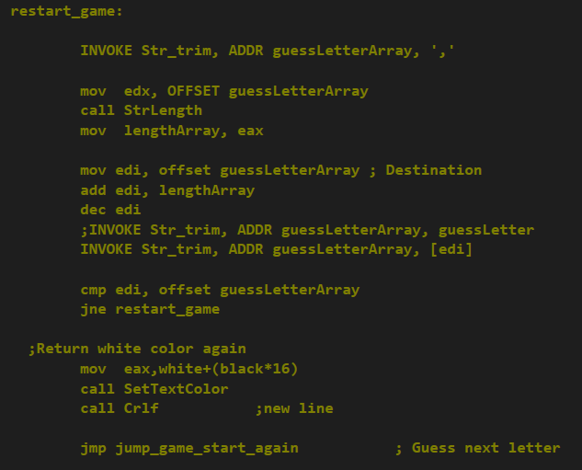
Main Proc Block 8:
Procedure for Restarting the game.

Slide 12
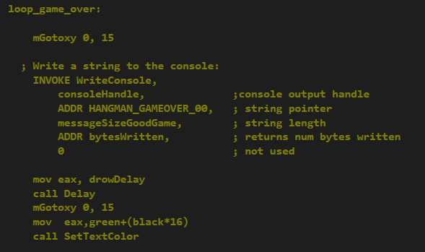
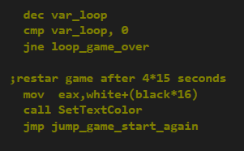
Main Proc Block 9:
Procedure for Game Over.

Slide 13
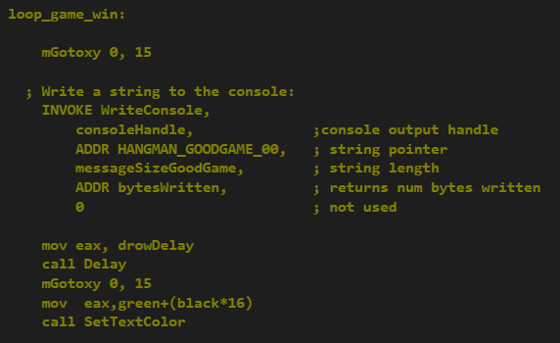
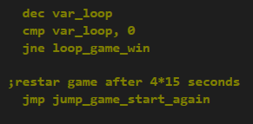
Main Proc Block 10:
Procedure for Game Won.

Slide 14
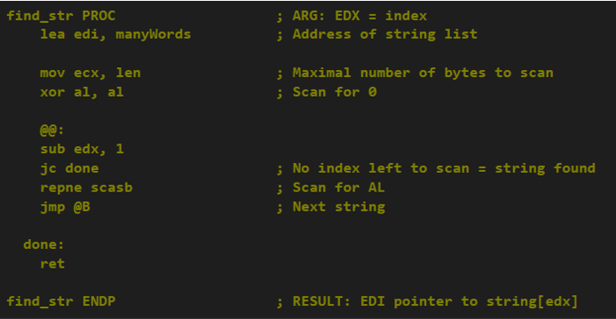
Find_Str Proc

Slide 15
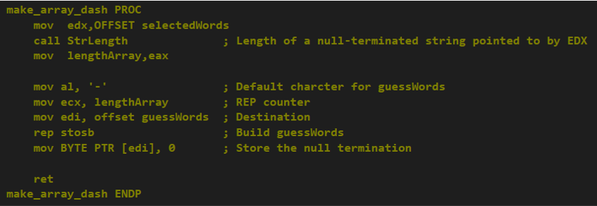
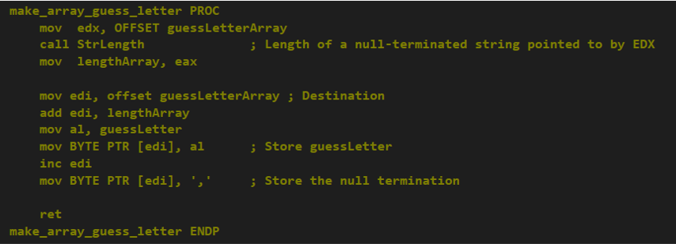
Make_Array_Dash Proc
Make_Array_Guess_Letter Proc

Slide 16
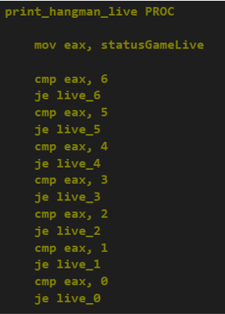
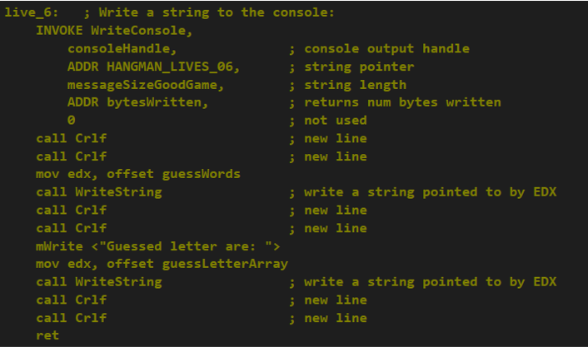
Print_Hangman_live Proc

Slide 17
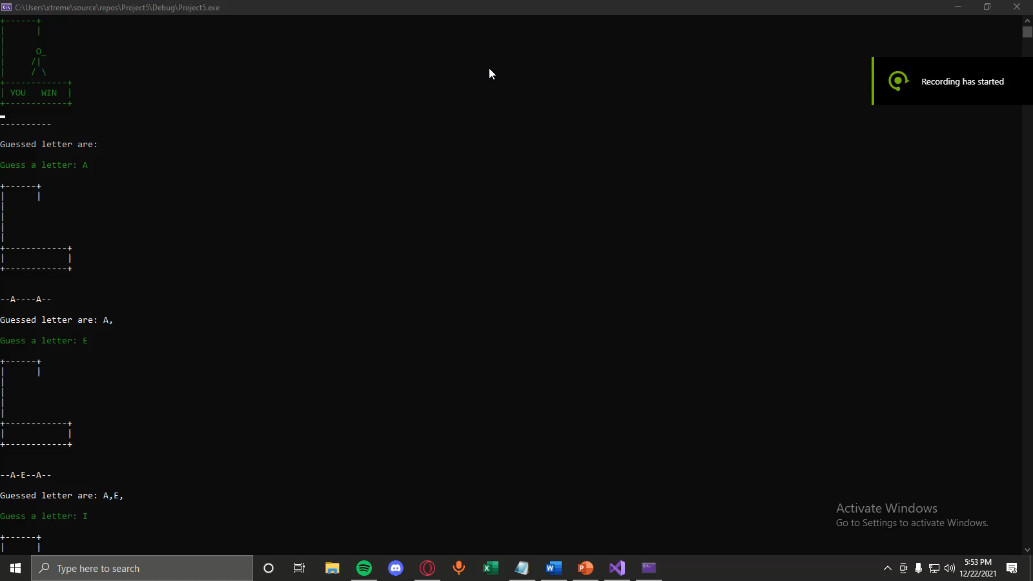
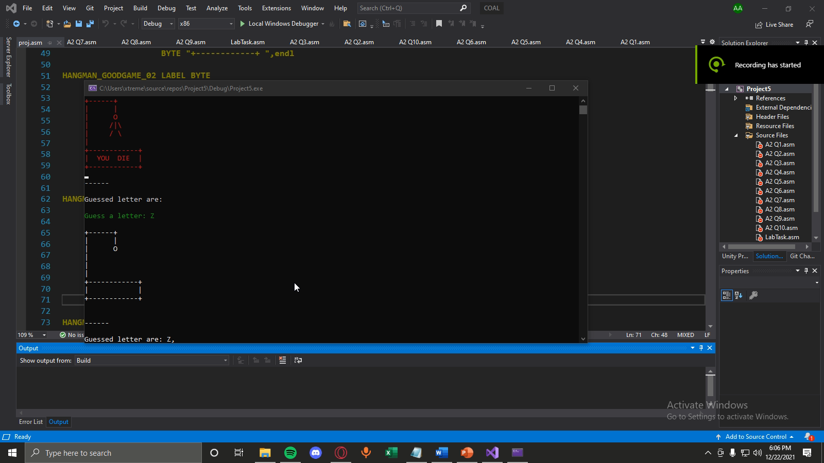
Animations
Win
Lose

Slide 18
Thank You For Listening To The Boring Part!

